Slide 1
Hierarchical Phasers for Scalable Synchronization and Reductions in Dynamic Parallelism
IPDPS 2010
April 22nd, 2010
Jun Shirako and Vivek Sarkar
Rice University

Slide 2
Introduction
Major crossroads in computer industry
Processor clock speeds are no longer increasing
⇒ Chips with increasing # cores instead
Challenge for software enablement on future systems
~ 100 and more cores on a chip
Productivity and efficiency of parallel programming
Need for new programming model
Dynamic Task Parallelism
New programming model to overcome limitations of Bulk Synchronous Parallelism (BSP) model
Chapel, Cilk, Fortress, Habanero-Java/C, Intel Threading Building Blocks, Java Concurrency Utilities, Microsoft Task Parallel Library, OpenMP 3.0 and X10
Set of lightweight tasks can grow and shrink dynamically
Ideal parallelism expressed by programmers
Useful parallelism on target platforms extracted by compiler/runtime
Notes:
VIVEK: “Set of lightweight tasks can grow and shrink dynamically”

Slide 3
Introduction
Habanero-Java/C
http://habanero.rice.edu, http://habanero.rice.edu/hj
Task parallel language and execution model built on four orthogonal constructs
Lightweight dynamic task creation & termination
Async-finish with Scalable Locality-Aware Work-stealing scheduler (SLAW)
Locality control with task and data distributions
Hierarchical Place Tree
Mutual exclusion and isolation
Isolated
Collective and point-to-point synchronization & accumulation
Phasers
This paper focuses on enhancements and extensions to phaser constructs
Hierarchical barrier implementation for scalability
Synchronization in the presence of dynamic parallelism
Notes:
Lightweight dynamic task creation & termination
VIVEK: Async-finish with Scalable Locality-Aware Work-stealing scheduler (SLAW)
Locality control with task and data distributions
Hierarchical Place Tree

Slide 4
Outline
Introduction
Habanero-Java parallel constructs
Async, finish
Phasers
Hierarchical phasers
Programming interface
Runtime implementation
Experimental results
Conclusions

Slide 5
Async and Finish
Based on IBM X10 v1.5
Async = Lightweight task creation
Finish = Task-set termination
Join operation
finish {
// T₁
async { STMT1; STMT4; STMT7; } //T₂
async { STMT2; STMT5; } //T₃
STMT3; STMT6; STMT8; //T₁
}
T₁
T₂
T₃
async
STMT 3
STMT 1
STMT 2
Dynamic parallelism
STMT 6
STMT 4
STMT 5
STMT 8
STMT 7
wait
End finish
Notes:
VIVEK: Task-set termination

Slide 6
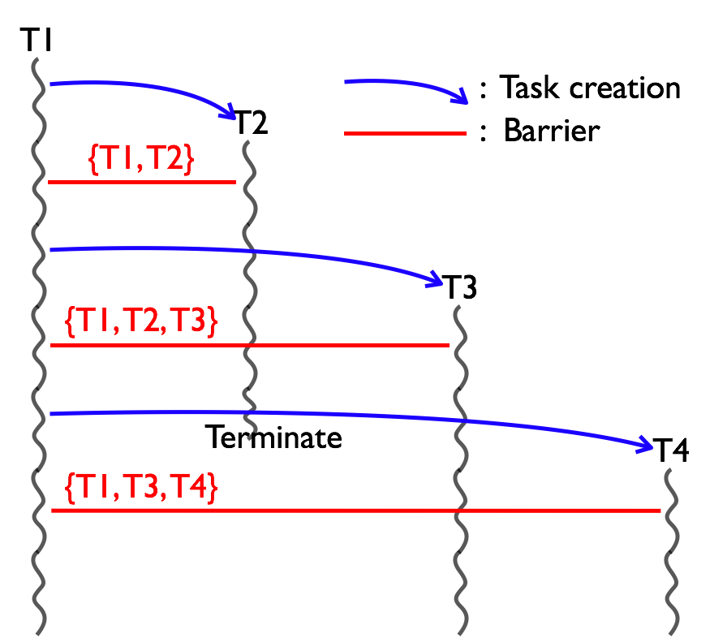
Phasers
Designed to handle multiple communication patterns
Collective Barriers
Point-to-point synchronizations
Supporting dynamic parallelism
# tasks can be varied dynamically
Deadlock freedom
Absence of explicit wait operations
Accumulation
Reductions (sum, prod, min, …)
combined with synchronizations
Streaming parallelism
As extensions of accumulation to support buffered streams
References
[ICS 2008] “Phasers: a Uniﬁed Deadlock-Free Construct for Collective and Point-to-point Synchronization”
[IPDPS 2009] “Phaser Accumulators: a New Reduction Construct for Dynamic Parallelism”

Slide 7
Phasers
Phaser allocation
phaser ph = new phaser(mode)
Phaser ph is allocated with registration mode
Mode:
Task registration
async phased (ph₁<mode₁>, ph₂<mode₂>, … ) {STMT}
Created task is registered with ph₁ in mode₁, ph₂ in mode₂, …
child activity’s capabilities must be subset of parent’s
Synchronization
next:
Advance each phaser that activity is registered on to its next phase
Semantics depend on registration mode
Deadlock-free execution semantics
SINGLE
Registration mode defines capability
There is a lattice ordering of capabilities
SIG_WAIT(default)
SIG
WAIT
Notes:
VIVEK: Deadlock-free execution semantics

Slide 8
Using Phasers as Barriers with Dynamic Parallelism
finish {
phaser ph = new phaser(SIG_WAIT); //T₁
async phased(ph<SIG_WAIT>){ STMT1; next; STMT4; next; STMT7; }//T₂
async phased(ph<SIG_WAIT>){ STMT2; next; STMT5; } //T₃
STMT3; next; STMT6; next; STMT8; //T₁
}
T₁
T₂
T₃
T₁ , T₂ , T₃ are registered
on phaser ph in SIG_WAIT
async
STMT 3
STMT 1
STMT 2
Dynamic parallelism
set of tasks registered
on phaser can vary
next
next
next
STMT 6
STMT 4
STMT 5
next
next
STMT 8
STMT 7
wait
End finish

Slide 9
Phaser Accumulators for Reduction
phaser ph = new phaser(SIG_WAIT);
accumulator a = new accumulator(ph, accumulator.SUM, int.class);
accumulator b = new accumulator(ph, accumulator.MIN, double.class);
// foreach creates one task per iteration
foreach (point [i] : [0:n-1]) phased (ph<SIG_WAIT>) {
int iv = 2*i + j;
double dv = -1.5*i + j;
a.send(iv);
b.send(dv);
// Do other work before next
next;
int sum = a.result().intValue();
double min = b.result().doubleValue();
…
}
Allocation: Specify operator and type
send: Send a value to accumulator
next: Barrier operation; advance the phase
result: Get the result from previous phase (no race condition)

Slide 10
Scalability Limitations of Single-level Barrier + Reduction (EPCC Syncbench) on Sun 128-thread Niagara T2
513
1479
Single-master / multiple-worker implementation
Bottleneck of scalability
Need support for tree-based barriers and reductions, in the presence of dynamic task parallelism

Slide 11
Outline
Introduction
Habanero-Java parallel constructs
Async, finish
Phaser
Hierarchical phasers
Programming interface
Runtime implementation
Experimental results
Conclusions

Slide 12
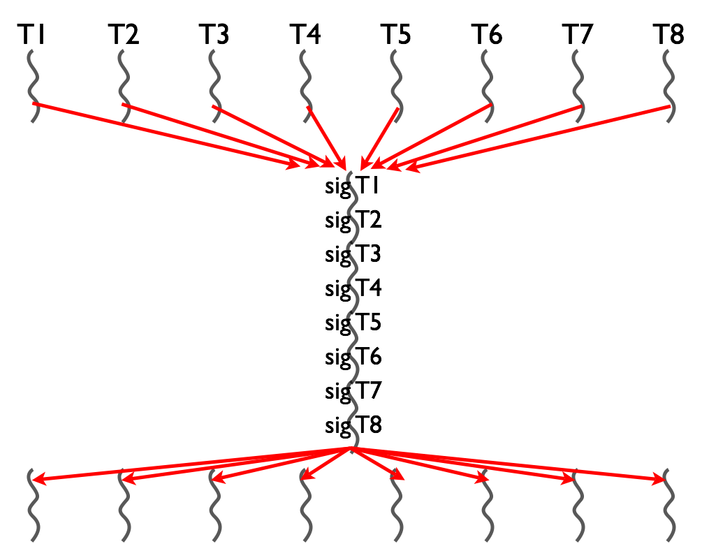
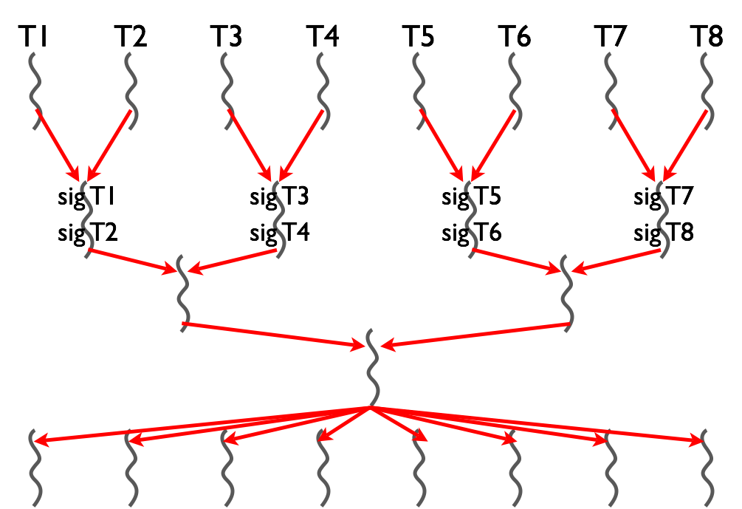
Flat Barrier vs. Tree-Based Barriers
gather
Master task
receive signals
sequentially
sub-masters in the same tier receive
signals in parallel
broadcast
Barrier = gather + broadcast
Gather: single-master implementation is a scalability bottleneck
Tree-based implementation
Parallelization in gather operation
Well-suited to processor hierarchy
Notes:
TODO:
1) increase font size for “Sub-masters in the same tier receive signals in parallel”
2) Replace “Master” in oval by “Master task”

Slide 13
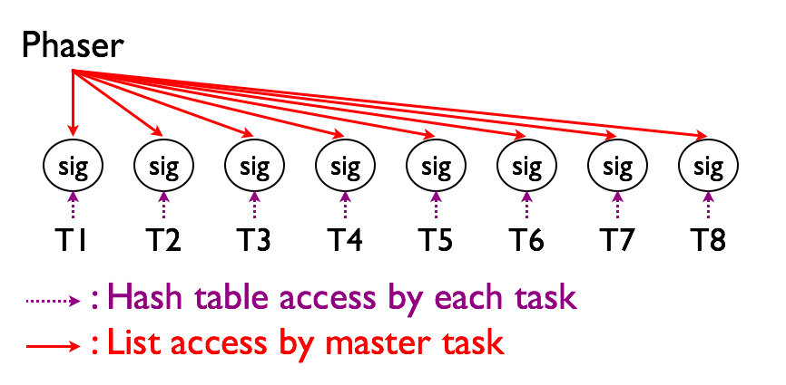
Flat Barrier Implementation
Gather by single master
class phaser {
List <Sig> sigList;
int mWaitPhase;
...
}
class Sig {
volatile int sigPhase;
...
}
// Signal by each task
Sig mySig = getMySig();
mySig.sigPhase++;
// Master waits for all signals
// -> Major scalability bottleneck
for (.../*iterates over sigList*/) {
Sig sig = getAtomically(sigList);
while (sig.sigPhase <= mWaitPhase);
}
mWaitPhase++;
Notes:
TODO: add volatile declaration

Slide 14
API for Tree-based Phasers
Allocation
phaser ph = new phaser(mode, nTiers, nDegree);
nTiers: # tiers of tree
“nTiers = 1” is equivalent to flat phasers
nDegree: # children on a sub-master (node of tree)
Registration
Same as flat phaser
Synchronization
Same as flat phaser
(nTiers = 3, nDegree = 2)
Tier-2
Tier-1
Tier-0

Slide 15
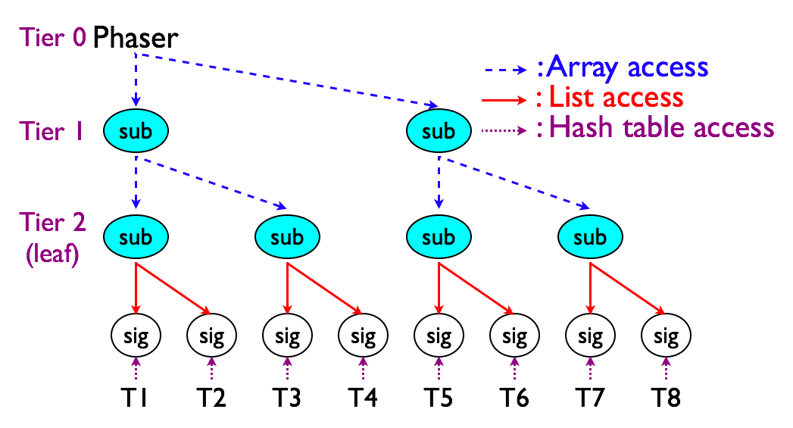
Tree-based Barrier Implementation
Gather by hierarchical sub-masters
class phaser {
...
// 2-D array [nTiers][nDegree]
SubPhaser [][] subPh;
...
}
class SubPhaser {
List <Sig> sigList;
int mWaitPhase;
volatile int sigPhase;
... }
nDegree = 2
Notes:
TODO: add volatile declarations

Slide 16
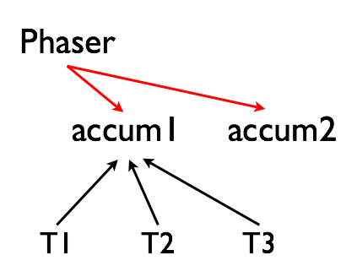
Flat Accumulation Implementation
Single atomic object in phaser
class phaser {
List <Sig>sigList;
int mWaitPhase;
List <accumulator>accums;
...
}
class accumulator {
AtomicInteger ai;
Operation op;
Class dataType;
...
void send(int val) {
// Eager implementation
if (op == Operation.SUM) {
...
}else if(op == Operation.PROD){
while (true) {
int c = ai.get();
int n = c * val;
if (ai.compareAndSet(c,n))
break;
else
delay();
}
} else if ...
heavy contention
on an atomic object
…
a.send(v)
a.send(v)
a.send(v)
Notes:
TODO: add volatile declarations

Slide 17
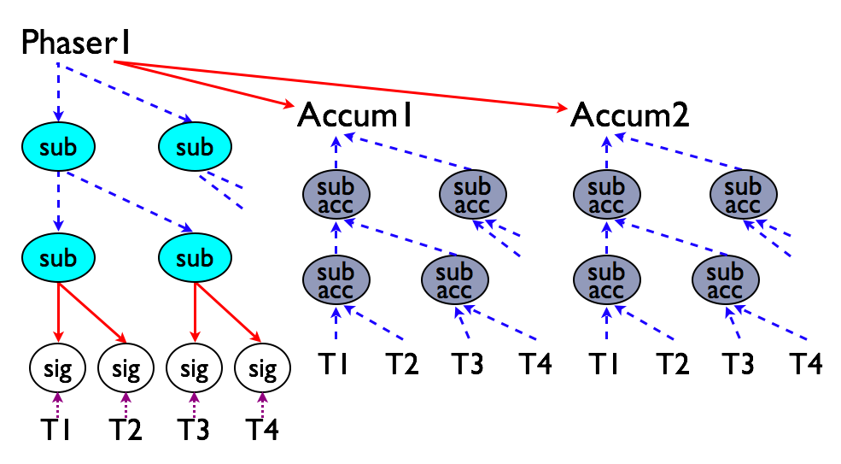
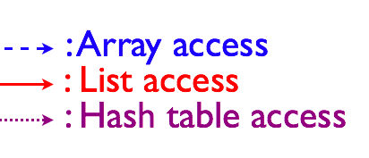
Tree-Based Accumulation Implementation
Hierarchical structure of atomic objects
class phaser {
int mWaitPhase;
List <Sig>sigList;
List <accumulator>accums;
...
}
class accumulator {
AtomicInteger ai;
SubAccumulator subAccums [][];
... }
class SubAccumulator {
AtomicInteger ai;
... }
nDegree = 2, lighter contention
Notes:
TODO:
add volatile declarations
Fix figure for wait operations (broadcast does not need tree)

Slide 18
Outline
Introduction
Habanero-Java parallel constructs
Async, finish
Phaser
Hierarchical phasers
Programming interface
Runtime implementation
Experimental results
Conclusions

Slide 19
Experimental Setup
Platforms
Sun UltraSPARC T2 (Niagara 2)
1.2 GHz
Dual-chip 128 threads (16-core x 8-threads/core)
32 GB main memory
IBM Power7
3.55 GHz
Quad-chip 128 threads (32-core x 4-threads/core)
256 GB main memory
Benchmarks
EPCC syncbench microbenchmark
Barrier and reduction performance
Java Grande Forum Benchmarks
LUFact, SOR and MolDyn
Nas Parallel Benchmarks 3.0
MG and CG

Slide 20
Experimental Setup
Experimental variants
JUC CyclicBarrier
Java concurrent utility
OpenMP for
Parallel loop with barrier
Supports reduction
OpenMP barrier
Barrier by fixed # threads
No reduction support
Phasers normal
Flat-level phasers
Phasers tree
Tree-based phasers
omp_set_num_threads(num);
// OpenMP for
#pragma omp parallel
{
for (r=0; r<repeat; r++) {
#pragma omp for
for (i=0; i < num; i++) {
dummy();
} /* Implicit barrier here */
}
}
// OpenMP barrier
#pragma omp parallel
{
for (r=0; r<repeat; r++) {
dummy();
#pragma omp barrier
}
}

Slide 21
Barrier Performance with EPCC Syncbench on Sun 128-thread Niagara T2
4551
920
1931
1289
1211
CyclicBarrier > OMP-for ≈ OMP-barrier > phaser
Tree-based phaser is faster than flat phaser when # threads ≥ 16

Slide 22
Barrier + Reduction with EPCC Syncbench on Sun 128-thread Niagara T2
513
1479
OMP for-reduction(+) > phaser-flat > phaser-tree
CyclicBarrier and OMP barrier don’t support reduction

Slide 23
Barrier Performance with EPCC Syncbench on IBM 128-thread Power7 (Preliminary Results)
88.2
186.0
379.4
831.8
CyclicBarrier > phaser-flat > OMP-for > phaser-tree > OMP-barrier
Tree-based phaser is faster than flat phaser when # threads ≥ 16

Slide 24
Barrier + Reduction with EPCC Syncbench on IBM 128-thread Power7
187.2
phaser-flat > OMP for + reduction > phaser-tree

Slide 25
Impact of (# Tiers, Degree) Phaser Configuration on Sun 128-thread Niagara T2
Barrier
Reduction
(2 tiers, 16 degree) shows best performance for both barriers and reductions

Slide 26
Impact of (# Tiers, Degree) Phaser Configuration on IBM 128-thread Power7
Barrier
Reduction
(2 tiers, 32 degree) shows best performance for barrier
(2 tiers, 16 degree) shows best performance for reduction

Slide 27
Application Benchmark Performance on Sun 128-thread Niagara T2
62.8
62.4
31.8
31.5
Notes:
TODO: add execution time below each benchmark label e.g.,
LUFact.C
(123.4s)

Slide 28
Preliminary Application Benchmark Performance on IBM Power7 (SMT=1, 32-thread)
Notes:
TODO: add execution time below each benchmark label e.g.,
LUFact.C
(123.4s)

Slide 29
Preliminary Application Benchmark Performance on IBM Power7 (SMT=2, 64-thread)
Notes:
TODO: add execution time below each benchmark label e.g.,
LUFact.C
(123.4s)

Slide 30
Preliminary Application Benchmark Performance on IBM Power7 (SMT=4, 128-thread)
For CG.A and MG.A, the Java runtime terminates with an internal error for 128 threads (under investigation)

Slide 31
Related Work
Our work was influenced by past work on hierarchical barriers, but none of these past efforts considered hierarchical synchronization with dynamic parallelism as in phasers
Tournament barrier
D. Hengsen, et. al., “Two algorithms for barrier synchronization”, International Journal of Parallel Programming, vol. 17, no. 1, 1988
Adaptive combining tree
R. Gupta and C. R. Hill, “A scalable implementation of barrier synchronization using an adaptive combining tree”, International Journal of Parallel Programming, vol. 18, no. 3, 1989
Extensions to combining tree
M. Scott and J. Mellor-Crummey, “Fast, Contention Free Combining Tree Barriers for Shared-Memory Multiprocessors,” International Journal of Parallel Programming, vol. 22, no. 4, pp. 449–481, 1994
Analysis of MPI Collective and reducing operations
J. Pjesivac-Grbovic, et. al., “Performance analysis of mpi collective operations”, Cluster computing, vol. 10, no. 2, 2007

Slide 32
Conclusion
Hierarchical Phaser implementations
Tree-based barrier and reduction for scalability
Dynamic task parallelism
Experimental results on two platforms
Sun UltraSPARC T2 128-thread SMP
Barrier
94.9x faster than OpenMP for, 89.2x faster than OpenMP barrier,
3.9x faster than flat level phaser
Reduction
77.2x faster than OpenMP for + reduction, 16.3x faster than flat phaser
IBM Power7 128-thread SMP
Barrier
1.4x faster than OpenMP for, 4.5x slower than OpenMP barrier,
2.1x faster than flat level phaser
Reduction
1.6x faster than OpenMP for + reduction,7.7x faster than flat phaser
Future work
Auto tuned selection of # tiers and degree on target platforms
Adaptive selection between tree-based or single-level phasers

Slide 33
Backup Slides

Slide 34
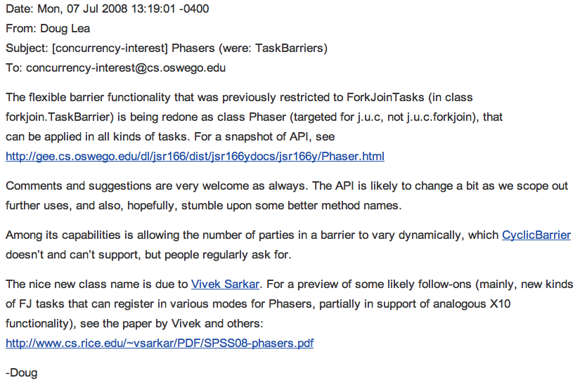
java.util.concurrent.Phaser library in Java 7
Implementation of subset of phaser functionality by Doug Lea in Java Concurrency library

Slide 35
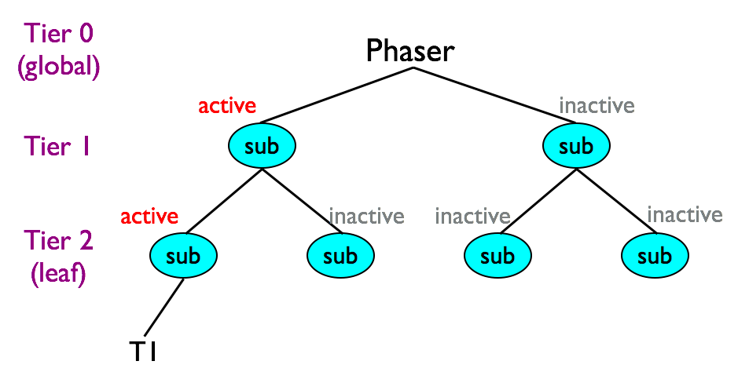
Tree Allocation
A task allocates phaser tree by “new phaser(…)”
The task is registered on a leaf sub-phaser
Only sub-phasers which the task accesses are active at the beginning
Inactive sub-phasers don’t attend barrier

Slide 36
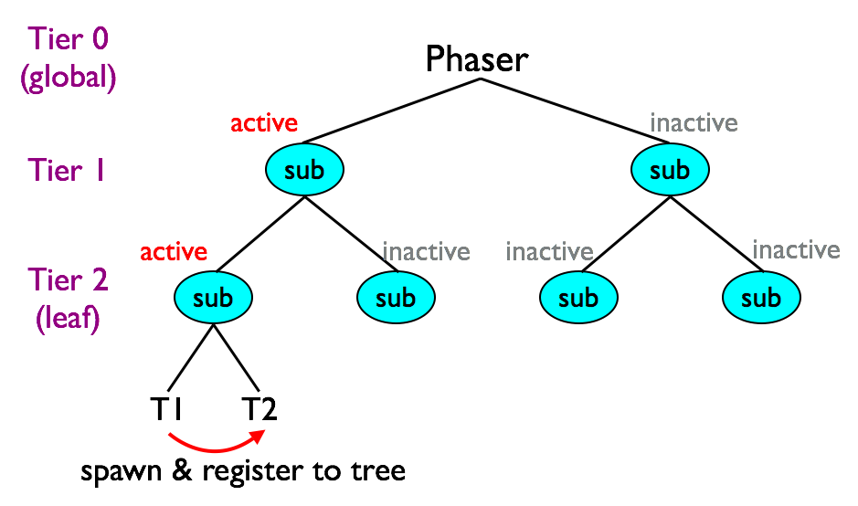
Task Registration (Local)
Tasks creation & registration on tree
Newly spawned task is also registered to leaf sub-phasers
Registration to local leaf when # tasks on the leaf < nDegrees

Slide 37
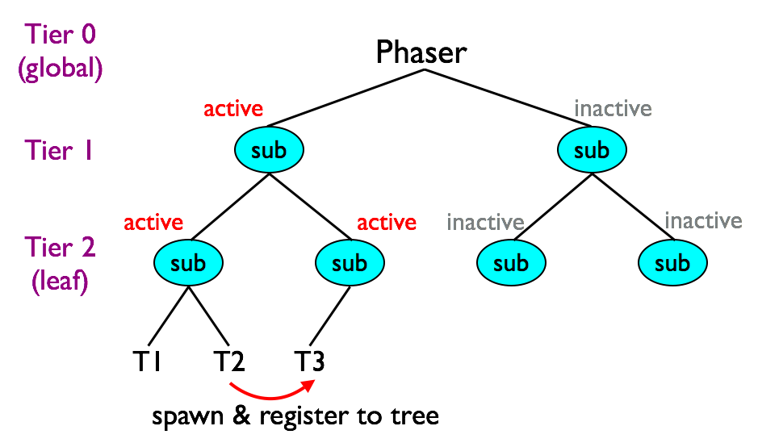
Task Registration (Remote)
Task creation & registration on tree
Registration to remote leaf when # tasks on the leaf ≥ nDegree
The remote sub-phaser is activated if necessary

Slide 38
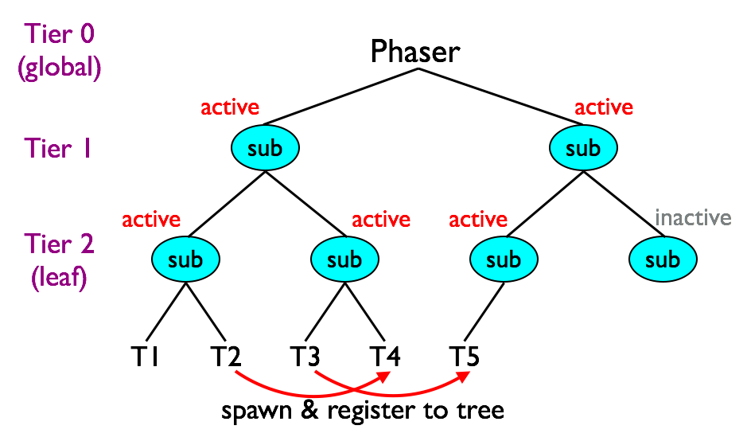
Task Registration (Remote)
Task creation & registration on tree
Registration to remote leaf when # tasks on the leaf ≥ nDegree
The remote sub-phaser is activated if necessary

Slide 39
Pipeline Parallelism with Phasers
finish {
phaser [] ph = new phaser[m+1];
// foreach creates one async per iteration
foreach (point [i] : [1:m-1]) phased (ph[i]<SIGNAL>, ph[i-1]<WAIT>)
for (int j = 1; j < n; j++) {
a[i][j] = foo(a[i][j], a[i][j-1], a[i-1][j-1]);
next;
} // for
} // foreach
} // finish
ph[1]<SIG>
ph[0]<WAIT>
ph[2]<SIG>
ph[1]<WAIT>
ph[3]<SIG>
ph[2]<WAIT>
ph[4]<SIG>
ph[3]<WAIT>
ph[0]
T₁
ph[1]
T₂
ph[2]
T₃
ph[3]
T₄
(i=1, j=1)
(i=2, j=1)
(i=3, j=1)
(i=4, j=1)
next
next
next
next
(i=1, j=2)
(i=2, j=2)
(i=3, j=2)
(i=4, j=2)
next
next
next
next
(i=1, j=3)
(i=2, j=3)
(i=3, j=3)
(i=4, j=3)
next
next
next
next
(i=1, j=4)
(i=2, j=4)
(i=3, j=4)
(i=4, j=4)
next
next
next
next

Slide 40
Thread Suspensions for Workers
Wait for master in busy-wait loop
Call Object.wait() to suspend (release CPU)
doWait() {
WaitSync myWait = getCurrentActivity().waitTbl.get(this);
if (isMaster(…)) { … } else { // Code for workers
boolean done = false;
while (!done) {
for (int i = 0; < WAIT_COUNT; i++) {
if (masterSigPhase > myWait.waitPhase) {
done = true; break;
} }
if (!done) {
int currVal = myWait.waitPhase;
int newVal = myWait.waitPhase + 1;
castID.compareAndSet(currVal, newVal);
synchronized (myWait) {
if (masterSigPhase <= myWait.waitPhase)
myWait.wait(); // Java library wait operation
} } } }
Programmer can specify

Slide 41
Wake suspended Workers
Call Object.notify() to wake workers up if necessary
doWait() {
WaitSync myWait = getCurrentActivity().waitTbl.get(this);
if (isMaster(…)) {// Code for master
waitForWorkerSignals(); masterWaitPhase++;
masterSigPhase++;
int currVal = masterSigPhase-1;
int newVal = masterSigPhase;
if (!castID.compareAndSet(currVal, newVal)) {
for (int i = 0; i < waitList.size(); i++) {
final WaitSync w = waitList.get(i);
synchronized (w) {
waitObj.notifyAll(); // Java library notify ope
}
}
}
} else { … }
}

Slide 42
Accumulator API
Allocation (constructor)
accumulator(Phaser ph, accumulator.Operation op, Class type);
ph: Host phaser upon which the accumulator will rest
op: Reduction operation
sum, product, min, max, bitwise-or, bitwise-and and bitwise-exor
type: Data type
byte, short, int, long, float, double
Send a data to accumulator in current phase
void Accumulator.send(Number data);
Retrieve the reduction result from previous phase
Number Accumulator.result();
Result is from previous phase, so no race with send
42
Notes:
42
TODO: insert example form LCPC 1997 paper

Slide 43
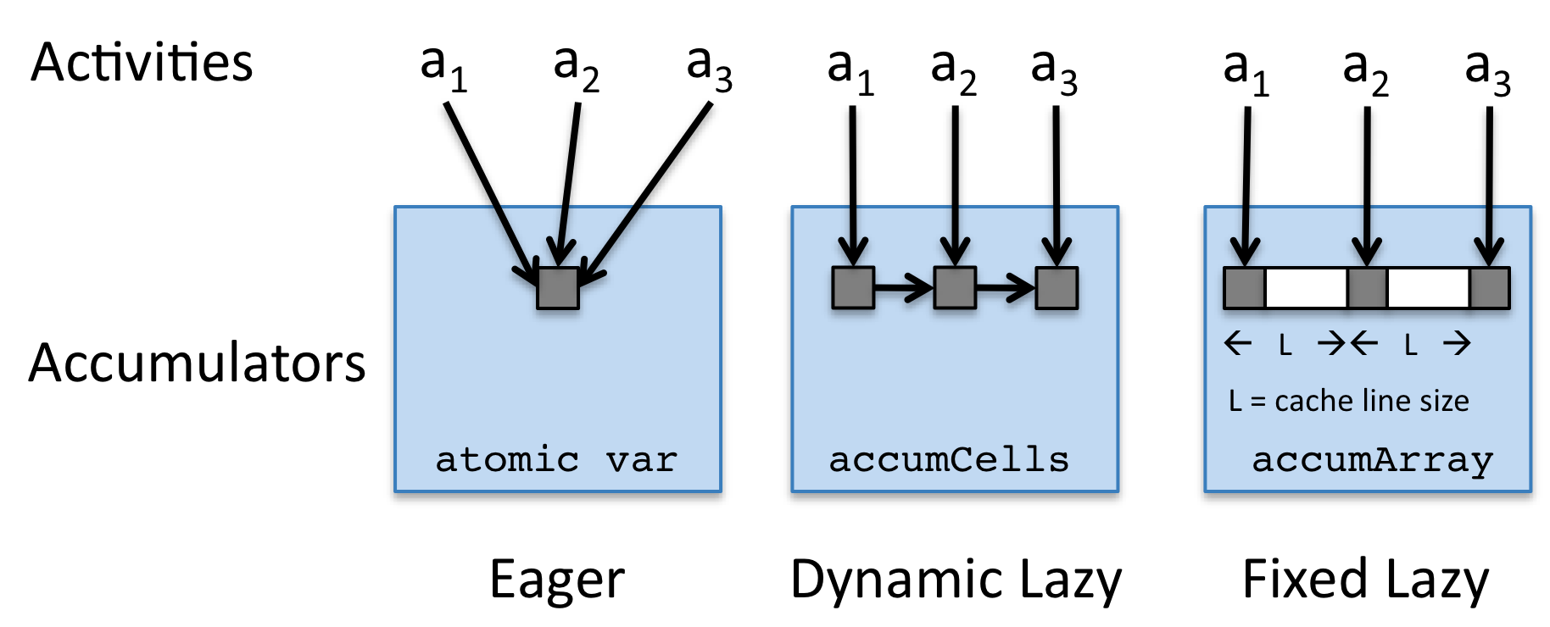
Different implementations for the accumulator API
Eager
send: Update an atomic var in the accumulator
next: Store result from atomic var to read-only storage
Dynamic-lazy
send: Put a value in accumCell
next: Perform reduction over accumCells
Fixed-lazy
Same as dynamic-lazy (accumArray instead of accumCells)
Lightweight implementations due to primitive array access
For restricted case of bounded parallelism (up to array size)
* fixed size array
Notes:
TODO: insert example form LCPC 1997 paper

