Slide 1
eScience in the Cloud: A MODIS Satellite Data Reprojection and Reduction Pipeline in the Windows Azure Platform
Jie Li¹, Deb Agarwal², Marty Humphrey¹, Keith Jackson²,
Catharine van Ingen³, Youngryel Ryu⁴
University of Virginia eScience Group¹
Lawrence Berkeley National Lab²
Microsoft Research³
University of California, Berkeley⁴
IPDPS - April 20, 2010

Slide 2
Outline
Background
AzureMODIS Framework Overview
Dynamic Scalability & Fault Tolerance
Evaluation
Conclusions & Future Work

Slide 3
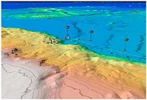

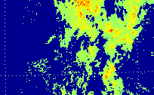
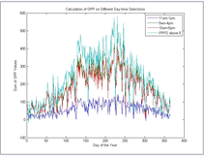
Data-intensive eScience: Opportunities
Increasing data availability for science discoveries
  Growing data size from large scientific instruments
  Emerging large-scale inexpensive ground-based sensors
Computational models with increasing complexities and precisions
?
Resources?
Apps &Tools?
Raw Data
Scientific Results

Slide 4
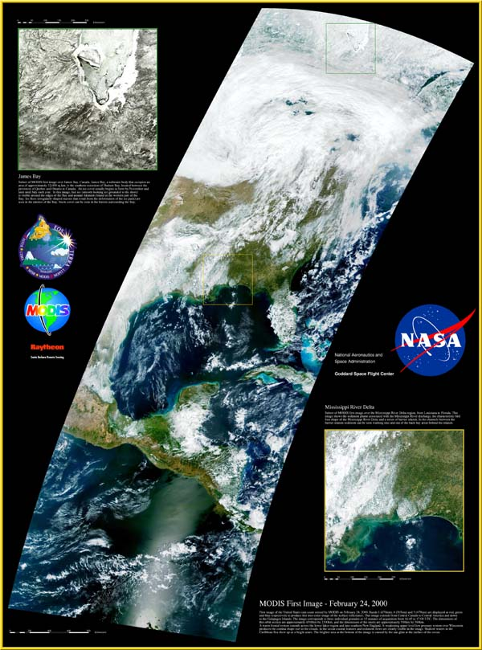
MODIS Basics
Moderate Resolution Imaging Spectroradiometer Satellites:
  Viewing the entire Earth's surface every 1 to 2 days
  Acquiring data in 36 spectral bands
  Multiple data products (Atmosphere, Land, Ocean etc.)
  Important for understanding global environment and earth system models
http://aqua.nasa.gov/doc/viz/media/aqua_orbit_sm.mpg

Slide 5
Barriers for Using MODIS Data
Data Collection
  Multiple FTP sites for MODIS source data
  Metadata maintained separately
Data Heterogeneity
  Different time granularities and imaging resolutions
  Two different project types: “Swath” and “Sinusoidal”
Data Management
  Current use case: 10 years of data covering US continent
  5 TB source data (~600,000 files)
  2 TB timeframe- and space-aligned harmonized data
  ~50000 CPU hours of parallel computation

Slide 6
AzureMODIS: A Client+Cloud Solution
A MODIS Data Processing Framework in Microsoft Windows Azure cloud computing platform
  Leverage scalability of cloud infrastructure and services
  Dynamic, on-demand resource provisioning
  Automate data processing tasks to eliminate barriers
  A generic Reduction Service to run arbitrary analysis executables
Windows Azure
Cloud Computing Platform
MODIS Source Data
AzureMODIS Service Framework
Scientific Results

Slide 7
Outline
Background
AzureMODIS Framework Overview
Dynamic Scalability & Fault Tolerance
Evaluation
Conclusions & Future Work

Slide 8
Windows Azure Platform Basics
Hosted Services
  Web Role: Host web applications via an HTTP and/or an HTTPS endpoint
  Worker Role: Host user-customized code/applications
Storage Services
  Blob service: Storage for entities in the form of binary bits
  Queue Service: A reliable, persistent queue model for message-based communication between instances
  Table Service: Structured storage in the form of tables, with simple query support

Slide 9
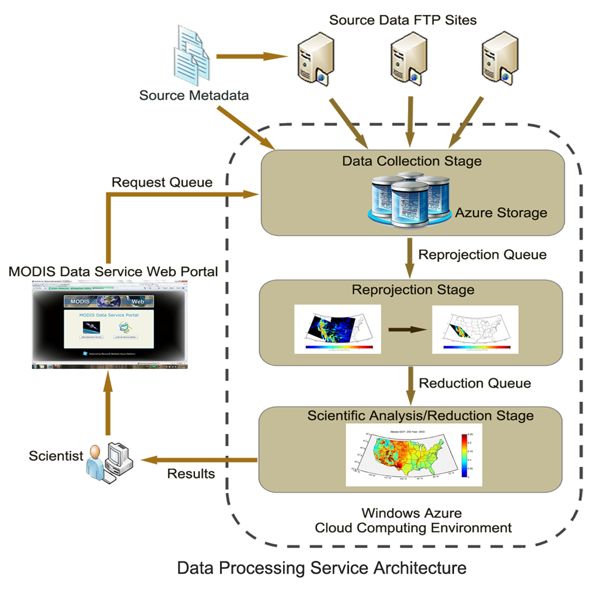
AzureMODIS Data Processing Service
3. Service Workers query the metadata in Azure tables to download source
2. The request is received and processed by the service monitor
4. The specified source data are uploaded to the Azure blob storage
1. Scientist submits requests for computation on the web portal
5. The heterogeneous sources are reprojected into uniform format
7. A single download link to the results is sent back to the scientist
6. Scientist uploads arbitrary executables to work on the uniform data

Slide 10
AzureMODIS Data Service Demo
http://modisazure.cloudapp.net/

Slide 11
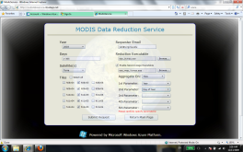


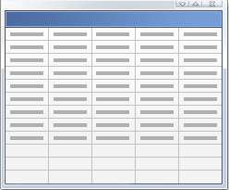



Behind the scene…
User
Web Portal
Job Request
ReductionJobStatus Table
Job Queue
…
Persist
(Web Role)
ReductionTaskStatus Table
Service Monitor (Worker Role)
Parse & Persist
Dispatch
Download
Link to Results
Points to
…
Task Queue
…
Sinusoidal Land
Source Storage
…
Reduction Result Storage
GenericWorker (Worker Role)
Reprojected Data
Storage

Slide 12
Data Caching
Blob storage level
  Each data file (blob) has a global unique identifier
  (Pre-)download and cache all source files in blob storage
  (Pre-)compute reprojection results for reuse across computations
Local machine level
  Each small size instance has ~250GB local storage
  Cache large size data files for reuse
Cost-related Trade offs
  Data re-generation cost VS. Blob storage cost
  For our case, data re-computation is too expensive

Slide 13
Reduction Service
Scientists upload their analysis binary tools upon request for the reduction service
Benefits
  Scientists can easily debug and refine scientific models in their code
  Separate system code debugging from science code debugging
A 2nd reduction stage to support more comprehensive computation flows

Slide 14
Outline
Project Background
AzureMODIS Framework Overview
Dynamic Scalability & Fault Tolerance
Evaluation
Conclusions & Future Work

Slide 15
Dynamic Scalability
Use the Azure Management API to dynamically scale up/down instances according to work loads
Dynamic instance shutdown could be a problem
  Azure decides which instance to shutdown
  Instances may be shutdown during task execution
Currently, computing instance usage are charged by hours
  Use CPU hours wisely when applying dynamic scaling strategies

Slide 16
Performance of dynamic instance scaling
Instance Start Up Time (Test Date: March 31, 2010)
In contrast, the shutdown time for the instances is small (usually within 3 minutes)

Slide 17
Fault Tolerance
Tasks can fail for many reasons
  Broken or missing source data files — Unrecoverable
  Reduction tool may crash due to code bug — Unrecoverable
  Failures caused by system instability — Recoverable
Customized task retry policies
  Task with timeout failures will be resent to the task queue
  Task with exceptions caught will be immediately resent
  Task canceled after 2 retries (Totally 3 executions)
Why not just use queue message visibility settings for failure recovery?

Slide 18
Service Monitoring & Diagnosing (Demo)
http://modisazure.cloudapp.net/

Slide 19
Outline
Project Background
AzureMODIS Framework Overview
Dynamic Scalability & Fault Tolerance
Evaluation
Conclusions & Future Work

Slide 20
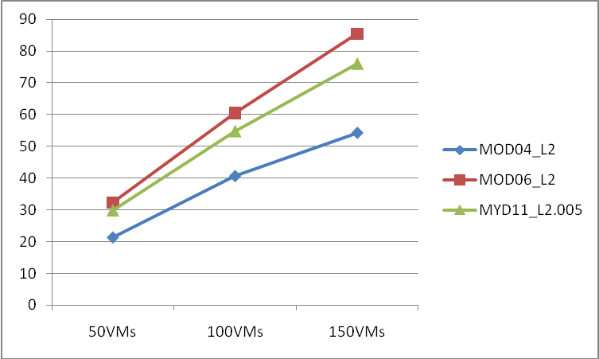
Overall Performance & Scalability
Table 2. Capacity of desktop machine and a single Azure instance
 | Desktop | Azure Instance
Capacity | CPU: Intel Core2Duo E6850 @ 3.0GHZ Memory: 4GB Hard Disk: 1TB SATA Network: 1Gbps Ethernet OS: Windows 7 (32-bit) | CPU: 1.6GHZ X64 equivalent processor Memory: 2GB Local Storage: 250GB Network: 100Mbps OS: Windows 2008 Server x64 (64-bit)
Table 3. Processing time for 1500 reprojection tasks (Unit: hours)
 | MOD04_L2 | MOD06_L2 | MYD11_L2.005
150 instances | 0.30 | 0.85 | 0.44
100 instances | 0.40 | 1.20 | 0.61
50 instances | 0.76 | 2.25 | 1.12
Desktop | 16.29 | 72.62 | 33.45
Fig. 1 Performance speedups over a single desktop

Slide 21
Storage Service Scalability
Accumulated time for data transfer from/to Azure blob storage increases as #VM increases

Slide 22
Outline
Project Background
AzureMODIS Framework Overview
Dynamic Scalability & Fault Tolerance
Evaluation
Conclusions & Future Work

Slide 23
Conclusions
Cloud computing provides new capabilities and opportunities for data-intensive eScience research
Dynamic scalability is powerful, but instance start up overhead is not trivial
Built-in fault tolerance & diagnostic features are important in the face of common failures in large-scale cloud applications and systems

Slide 24
Future Work
Scale up computations from US continent to the global scale
Develop and evaluate a generic dynamic scaling mechanism with AzureMODIS
Evaluate the similarities/differences between our framework and other generic parallel computing frameworks such as MapReduce

Slide 25
Thank you!
&
Questions?

