Slide 1
Direct Self-Consistent Field Computations on GPU Clusters
Guochun Shi,
Volodymyr Kindratenko
National Center for Supercomputing Applications
University of Illinois at Urbana-Champaign
Ivan Ufimtsev,
Todd Martinez
Department of Chemistry
Stanford University

Slide 2
Presentation Outline
GPU computing
  NCSA’s Lincoln GPU cluster
SCF theory in Quantum Chemistry
Implementation on a GPU cluster
  Kernels for J and K matrices
  Parallelization strategy for GPU cluster
  Performance
Conclusions and future work

Slide 3
Why GPUs?
GPU Performance Trends
7800 GTX
6800 Ultra
5800
5950 Ultra
Notes:
Single Precision now, double precision getting increased focus as market is realized

Slide 4
NVIDIA Tesla T10 GPU Architecture
T10 architecture
  240 streaming processors arranged as 30 streaming multiprocessors
  At 1.3 GHz this provides
    1 TFLOP SP
    86.4 GFLOP DP
  512-bit interface to off-chip GDDR3 memory
    102 GB/s bandwidth
PCIe interface
Input assembler
Thread execution manager
TPC 1
TPC 10
Geometry controller
Geometry controller
SMC
SMC
SM
SM
SM
SM
SM
SM
I cache
I cache
I cache
I cache
I cache
I cache
MT issue
MT issue
MT issue
MT issue
MT issue
MT issue
C cache
C cache
C cache
C cache
C cache
C cache
SP
SP
SP
SP
SP
SP
SP
SP
SP
SP
SP
SP
SP
SP
SP
SP
SP
SP
SP
SP
SP
SP
SP
SP
SP
SP
SP
SP
SP
SP
SP
SP
SP
SP
SP
SP
SP
SP
SP
SP
SP
SP
SP
SP
SP
SP
SP
SP
SFU
SFU
SFU
SFU
SFU
SFU
SFU
SFU
SFU
SFU
SFU
SFU
Shared memory
Shared memory
Shared memory
Shared memory
Shared memory
Shared memory
Texture units
Texture units
Texture L1
Texture L1
512-bit memory interconnect
L2
ROP
ROP
L2
DRAM
DRAM
DRAM
DRAM
DRAM
DRAM
DRAM
DRAM

Slide 5
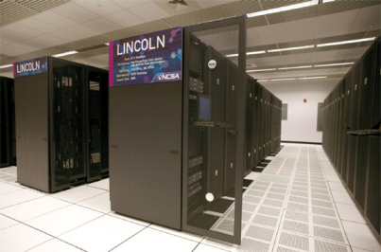
Intel 64 Tesla Linux Cluster Lincoln
Dell PowerEdge 1955 server
  Intel 64 (Harpertown) 2.33 GHz dual socket quad core
  16 GB DDR2
  Infiniband SDR
Tesla S1070 1U GPU Computing Server
  1.3 GHz Tesla T10 processors
  4x4 GB GDDR3 SDRAM
Cluster
  Servers: 192
  Accelerator Units: 96
Two Compute Nodes
IB
SDR IB
SDR IB
Dell PowerEdge 1955 server
Dell PowerEdge 1955 server
PCIe x8
PCIe x8
Tesla S1070
PCIe interface
PCIe interface
T10
T10
T10
T10
DRAM
DRAM
DRAM
DRAM

Slide 6
HPL Benchmark for Lincoln
We used Massimiliano Fatica(nvidia)’s GPU enabled HPL package.

Slide 7
Quantum Chemistry
Why do we need to deal with…
Energy (HΨ = EΨ):
Quantifies intra/intermolecular interactions
Drives chemistry, little interesting happens on flat surface
Geometry optimization (∇_{R}E = 0)
Searches for stable atomic arrangements (molecular shapes)
Molecular dynamics (∂²R/ ∂t² = -1/M ∇_{R}E)
The chemistry itself (at some, sometimes crude, approximation)
Studies system at atomistic time, and length scales

Slide 8
Exact energy is a hard problem

Slide 9
Hartree-Fock approximation is one of the simplest
Ψ is an antisymmetrized product of N 1-electron orbitals ψ
Expand ψ over predefined basis set ϕ

Slide 10
Hartree-Fock Self Consistent Field (SCF) procedure
Repeat until C_{k+1} more or less equals C_{k}

Slide 11
Hartree-Fock equations
All matrices are of N×N size (N ~ 1,000 … 10,000)
N³ operations to solve HF equations (need to deal with diagonalization)
N⁴ operations to get F

Slide 12
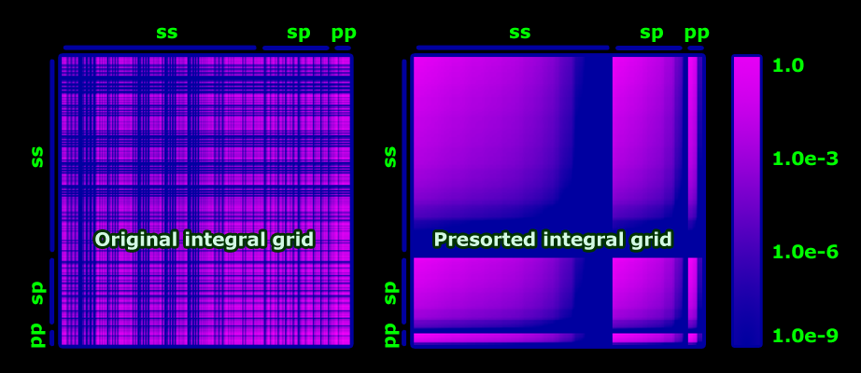
Kernel In GPU
2e integral grid
leaves only N² out of N⁴ integrals
|kl]
SIMD warp
SIMD warp
Most negligibly small integrals will be calculated
Only significant integrals will be calculated
[ij|

Slide 13
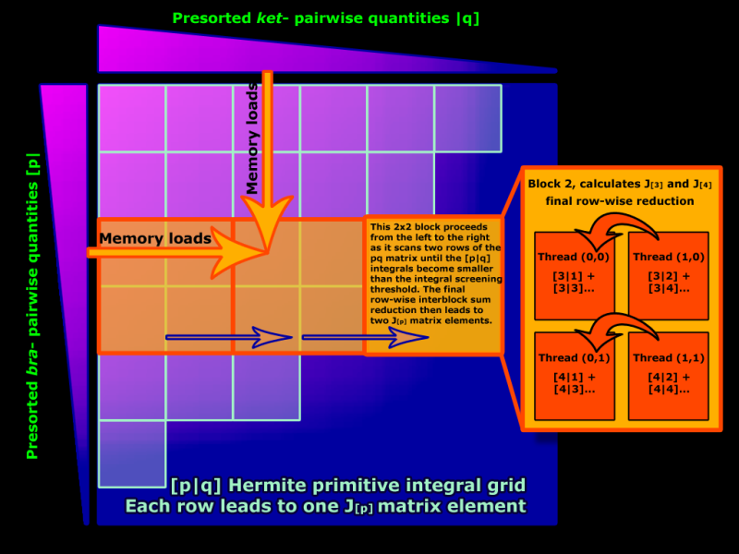
Kernel in GPU: J-matrix implementation

Slide 14
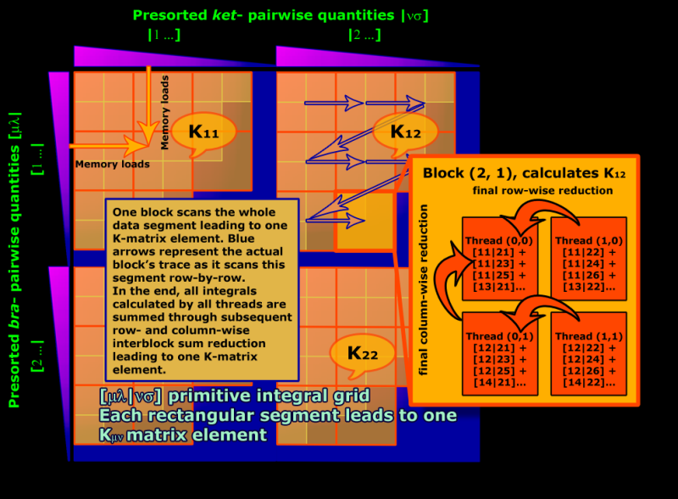
Kernels in GPU: K-matrix implementation

Slide 15
Singe node execution time breakdown
The J and K matrices computation and Linear Algebra (LA) computation dominate the overall execution time
Pair quantity computations can be significant

Slide 16
GPU cluster parallelization strategy
Each GPU has a global id
  nodeid * num_gpu_per_node + local_gpu_index
J/K matrices work distribution
  Computations for elements in J and K matrices are not even.
  Sort pre-computed pair quantities and choose every one element in N to compute for each GPU
LA using intel MKL

Slide 17
Parallelization strategy (II)
Start as MPI program, each node has as many MPI processes as CPU cores
One MPI process per node is designated as “master”
The master MPI processes create threads for controlling GPUs as well as CPU work threads
MPI processes/GPU management threads/CPU work threads are awaken or put to sleep as needed

Slide 18

MPI process
node 0
node 1
node 2
node 3
CPU work thread
CPU thread for managing GPU kernels
Generated guess matrix C and compute matrix P
Pair-quantity computing on CPU
Using density matrices P
Computing J and K matrices on GPUs
Partial J and K
Reduction of J and K matrices, form the Fock matrix
Fock matrix
Distribute the Fock matrix, do linear algebra, compute matrix C and P, gather P
Distr-ed fork matrix
Distr-ed P matrix
Broadcast P
P matrix

Slide 19
Performance: load balancing
Sorting for pair quantity computations and work selection strategy makes the computation on GPUs well balanced, reducing performance degradation

Slide 20

Performance
 | Atoms | Electrons | Orbitals | S shells | P shells
Olestra | 453 | 1366 | 2131 | 1081 | 350
BPTI | 875 | 3400 | 4893 | 2202 | 897
CspA | 1732 | 6290 | 8753 | 4220 | 1511
Runtime (s)
# of nodes
Using 321g basis set

Slide 21

Scalability of J, K and LA
number of nodes
J and K matrices computation can scale well to 128 nodes
Linear Algebra scales only up to 16 nodes even for CsPA molecule

Slide 22
Performance: Linear Algebra breakdown
Diagonization scales the worst, dgemm is also important
A fast, scalable GPU based SCALAPACK is needed
  Magma from UTK?
  Cula?

Slide 23
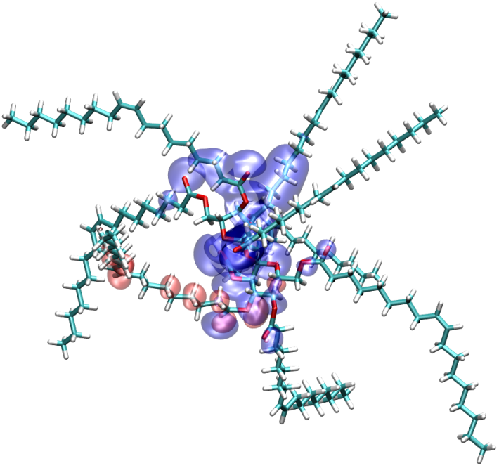
Results: Olestra molecule
Olestra molecule consisting of 453 atoms (a small example model used of testing the developed software) can be computed by the state-of-the-art quantum chemistry software package GAMESS running on an Intel Pentium D 3 GHz processor in over 12,408 seconds whereas our 8-node GPU cluster implementation performs the same computation in just over 5 seconds, a 2,452× speedup.

Slide 24
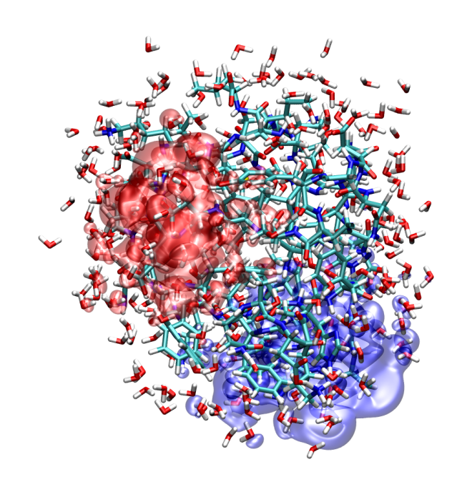
Example: CspA molecule
For larger models, one SCF iteration for Cold shock protein A (CspA) molecule consisting of 1,732 atoms can be done in 88 seconds on a 16 node GPU cluster.

Slide 25
Conclusions and future work
GPU computing brings Quantum Chemistry computing to a new level
Parallelization enables computing of large molecules in shorter time
  J and K matrices show good scalability
  Linear Algebra can only scale up to 16 nodes
Linear Algebra becomes a major bottleneck
  A linear algebra package using GPUs with good scalability is needed
    Matrix multiplication and eigenvalue solver
Only S and P orbitals are supported at this moment
  Alexey Titov (NCSA) is working on D orbitals

Slide 26
Acknowledgement
This work was supported by the National Science Foundation grant CHE-06-26354.

