Slide 1
Efficient Lists Intersection by CPU-GPU Cooperative Computing
Di Wu, Fan Zhang, Naiyong Ao, Gang Wang, Xiaoguang Liu, Jing Liu
Nankai-Baidu Joint Lab, Nankai University

Slide 2
Outline
Introduction
Cooperative Model
GPU Batching Algorithm
Experimental results
Related Work
Conclusion
Notes:
This is the agenda of this slides.

Slide 3
Outline
Introduction
Cooperative Model
GPU Batching Algorithm
Experimental results
Related Work
Conclusion
Notes:
This is the agenda of this slides.

Slide 4
Standard Query Processing
What are inverted index and inverted lists?
new 3, 16, 17, 24, 111, 127, 156, 777, 11437,…, 12457
york 15, 16, 17, 24, 88, 97,100, 156, 1234, 4356, …,12457
city 16, 29, 88, 97, 112, 156,4356, 8712, …,12457, 22888
Term
Document IDs
Notes:
We first look the most fundamental data structure for indexing and query processing, the inverted index.
Inverted index consists of many inverted lists containing a sorted list of document identifier (docid) and additional information such as term frequencies and positions of occurrences.

Slide 5
Standard Query Processing(cont.)
When a query “new york city” submitted to the search engine, these 3 inverted lists will be loaded from the inverted index, and intersection operation will be applied.
new 3, 16, 17, 24, 111, 127, 156, 777, 11437,…, 12457
york 15, 16, 17, 24, 88, 97,100, 156, 1234, 4356, …,12457
city 16, 29, 88, 97, 112, 156,4356, 8712, …,12457, 22888
Other operations in Search Engine
intersection
16, 156, …,12457

Slide 6
Problem
Lists intersection operation occupies a significant part of CPU time in the modern web search engine
The query traffic could be quite heavy
Tens of thousands queries could arrive to one server in just one second
Response time: the less the better
Could the new GPU technology solve these problem?

Slide 7
Graphical Processing Units (GPUs)
Special purposes processors to accelerate applications
Driven by gaming industry
Powerful parallel computing ability
Nvidia’s Compute Unified Device Architecture (CUDA)
A well-formed programming interface to the parallel architecture of Nvidia GPUs for general purpose computing
Notes:
Graphcai processing units or GPUs are designed to accelerate graphical applications, by using a lot of processors to work in parallel.
It is driven by the game industry and now more and more researchers are studying how to use it to do the general computing
Compared with CPU commonly it has more cores or processors

Slide 8
Our Goal
Improve the performance of lists intersection in real web search engines with the aid of GPU.

Slide 9
Outline
Introduction
Cooperative Model
GPU Batching Algorithm
Experimental results
Related Work
Conclusion
Notes:
This is the agenda of this slides.

Slide 10
Cooperative Model
In practice, the load of a web search engine is changing every time
The system throughput and response time could be impacted seriously when system load fluctuates violently.
Traditional asynchronous mode
Newly arriving query is serviced by an independent thread
Some queries will be blocked by previous queries under heavy load
CPU-GPU cooperative model

Slide 11
Asynchronous mode
Under light load, system works in asynchronous mode
Every newly arriving query will be processed immediately
Before processing the query, we determine the query should be processed in which processor - CPU or GPU
Trade off: Long lists or short lists
Trade off: GPU kernel time and transferring time between CPU and GPU

Slide 12
Synchronous mode
Under heavy load, the system works in synchronous mode, queries are grouped in batches and processed by GPU
Firstly, Queries are blocked at CPU end and sent to GPU by group
Group size is decided according to the query load and response time limitation
Problem
How to design an efficient GPU batching algorithm?
Tradeoff between throughout and response time
Notes:
Because GPU is specialized for compute-intensive, highly parallel computation. Process several queries simultaneously can make full use of GPU’s computation power.

Slide 13
Outline
Introduction
Cooperative Model
GPU Batching Algorithm
Experimental results
Related Work
Conclusion
Notes:
This is the agenda of this slides.

Slide 14
GPU Intersection algorithm
The basic idea for intersecting two lists intersection on GPU is parallel binary search
Assign each element of list₁ to a GPU thread
Do binary search in the list₂ to check whether the element is in list₂
Use scan and compact operation to generate the final result
Notes:
We first look at GPU lists intersection algorithm(only one query), and later we will see GPU batching algorithm(multi-query).

Slide 15
GPU Intersection algorithm(cont.)
list₂
8 | 20 | 30 | 44 | 45 | 50 | 54 | 55 | 60 | 65 | 70 | 80
Binary Search
list₁
10 | 20 | 30 | 40 | 45 | 48 | 55 | 57 | 65 | 80
0-1 array
0 | 1 | 1 | 0 | 1 | 0 | 1 | 0 | 1 | 1
parallel scan
0 | 0 | 1 | 2 | 2 | 3 | 3 | 4 | 4 | 5
Compact
result
20 | 30 | 45 | 55 | 65 | 80 | 0 | 0 | 0 | 0
Notes:
This page gives a explanation of how two lists intersect on GPU.

Slide 16
GPU Batching Algorithms
Pump enough queries to CPU at a time to make full use of SPs in GPU
Problem
How should change the original GPU intersection algorithm
How should we partition the work to balance the load for each GPU thread?
How to decide the number of queries in each batch
Two GPU batching algorithms
Query-Partition algorithm (PART)
Query-Parallel Algorithm (PARA)
Notes:
To fully use the GPU’s massive parallel computing power, we must use pump enough queries to CPU.

Slide 17
PART
In CUDA platform, threads are grouped in thread blocks
Synchronization between threads in different blocks is expensive
An intuitive idea to partition is assigning each query in the batch to a unique thread block
Queries may be quite different in lists’ lengths, this lead to huge diversity of computation complexity
some multiprocessors idling while the other multiprocessors still busy on their (big) queries

Slide 18
PARA
Process a query by several blocks cooperatively according to its size instead of assigning each query to a single block
Every block will have similar amount of load
We will compare PARA and PART in 3 aspects next
CPU preprocessing
GPU processing
Data transferring

Slide 19
CPU preprocessing
When a batch of N queries are ready, CPU will first sort lists in each query by increasing length, and send the batch to GPU
N is determined by total computation load of queries in the batch
Total computation load is estimated by a function of each query’s shortest list’s length (See in experiment section)
Compared with PART, PARA can control the total computation load delivered to GPU and load assigned to each block more precisely

Slide 20
GPU processing
Unlike PART’s query-block mapping, PARA adopts element-thread mapping
PARA assigns each element in the shortest list to a unique thread
PARA is more likely to distribute computation load evenly
PART and PARA both use binary search to check element, but there are some differences in the compact phase
For PARA: each thread is responsible for an element, a global scan is used.
For PART: each query is processed by a single block, so each block executes a sectionalized scan algorithm

Slide 21
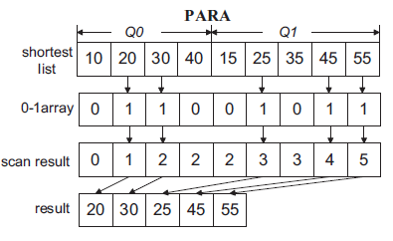
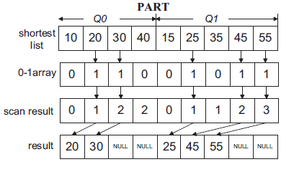
GPU processing(cont.)
PARA will transfer less result
data back to CPU!!

Slide 22
Data Transferring
The GPU(4GB global memory) we use could hold the two data sets, we upload the whole data set to GPU when initialization.
In a large-scale search engine, we could put those inverted lists which are most frequently accessed in GPU memory
For each batch, necessary information, such as terms of each query are uploaded to GPU before processing
The result data is sent back to CPU when a batch queries processed

Slide 23
Outline
Introduction
Cooperative Model
GPU Batching Algorithm
Experimental results
Related Work
Conclusion
Notes:
This is the agenda of this slides.

Slide 24
Environment
CPU
AMD
Memory
2GB*2
GPU Card
NVidia
C1060
PhenomIIX 4945
DDR3 1333 memory
Notes:
Next several pages, we will first see some experiment about the synchronous mode and then the asynchronous mode.

Slide 25
PARA on GOV data set
Computation threshold is used to control how many query a batch contains
We set the computation threshold according to the factors below
The computing power of GPU
Required system throughput
Required response time
We use “number of thread blocks on every SM” as the threshold
Notes:
Please refer to Paper: V Experiment, B Experimental Results 1) PARA on GOV data set

Slide 26
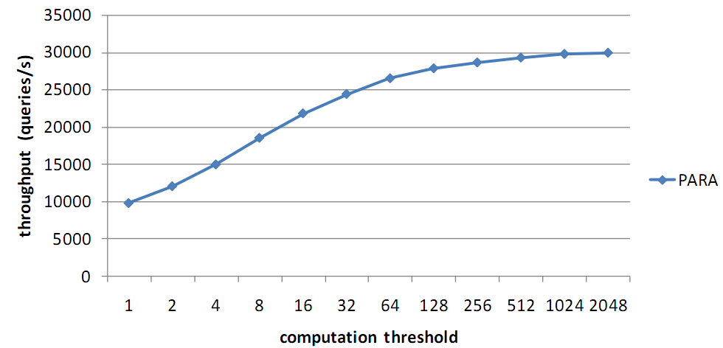
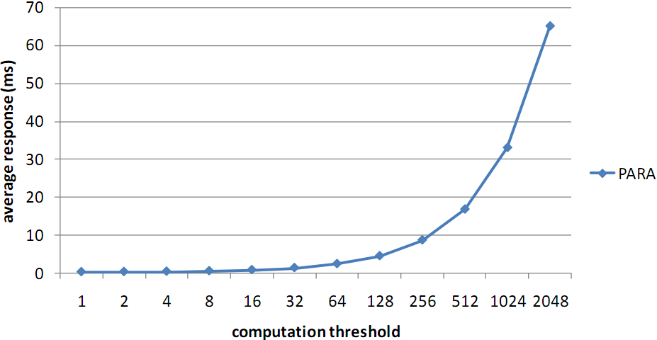
PARA on GOV data set
throughput
Up to 30K queries per second
Good tradeoff
response
Before B=128
Quite low response
Notes:
This two graph gives throughput and response time

Slide 27
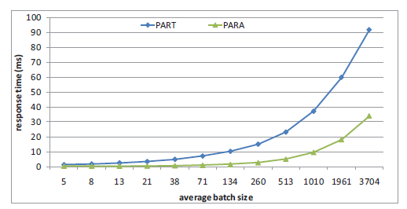
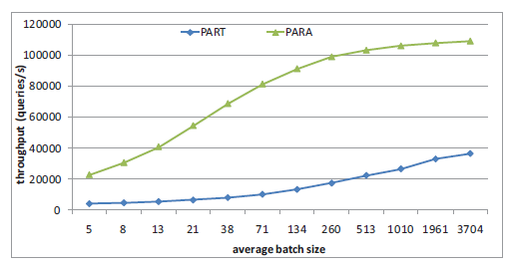
PART VS PARA
Response time
Throughput

Slide 28
Response time fluctuation
Response time fluctuation is bad to search engine
Violent fluctuations mean horrible user experience
Also, it will be difficult for administrator to predict system performance
Therefore, it is an important metric for real time system

Slide 29
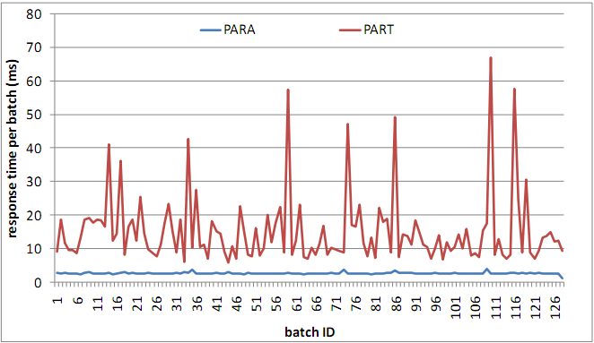
Response time fluctuation
Response time per batch
Blue line for PARA
Red line for PART
Response time in PARA is stable
PARA assembles batches according to computational complexity, so all batches have almost the same computation load

Slide 30
Query scheduling under asynchronous mode
If query load is light, system works in asynchronous mode
Both CPU and GPU can offer enough throughput
processing queries by CPU may lead to better response time
It is helpful to energy-saving by letting GPU idle
We need a routing-algorithm to decide which device to deal with the query, CPU or GPU

Slide 31
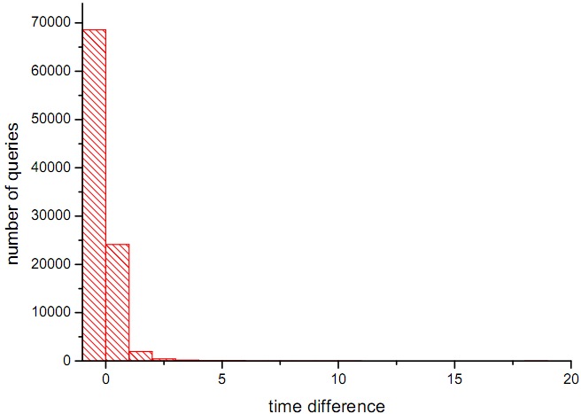
Route algorithm
Histogram
x-axis shows the time difference (CPU Time - GPU Time) per query
y-axis shows the number of queries
CPU has advantage over GPU on most queries, as these queries contains low computation complexity(short lists)
CPU has advantage over GPU on most queries
Notes:
The CPU uses an optimized single-thread list intersection algorithm.

Slide 32
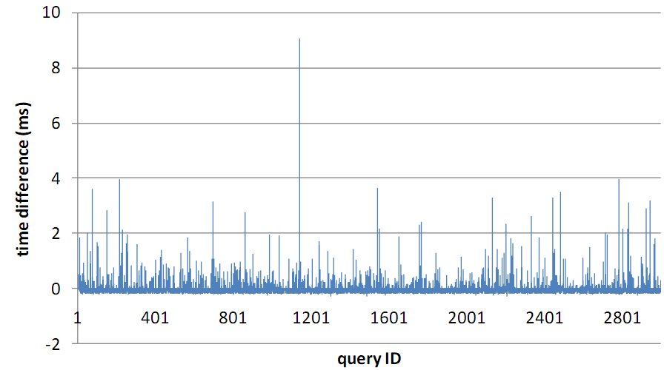
Route algorithm(cont.)
Graph
X-axis: query ID (we count 3000 queries, GOV data set)
Y-axis: time difference (CPU Time- GPU Time)
Compare
CPU’s s advantage is not significant
GPU is far superior in the queries whose computation complexity is high
?
How can we measure the computation complexity in each query?
GPU advantage
CPU advantage

Slide 33
Route algorithm(cont.)
What we have
The number of lists in each query
The length of each list
That is all …
The information is not enough
We do not know:
How many docIDs are common docIDs
Number of comparisons of each docIDs

Slide 34
Route algorithm(cont.)
We use statistical methods
We run each query (training set) on CPU and GPU separately, record the time difference
We introduce three metric to estimate the computational complexity
The scheduling algorithm boils down to the relationship between the time difference and each metrics.
We adopt regression analysis
to test the correlation between each metric and actual time difference

Slide 35
Route algorithm(cont.)
Metric to each query:
LOS: the length of the shortest list
UBOS: the upper bound of the number of comparisons
UBOS = LOS * (logL1 + logL2 + …)
UBOCT: the upper bound of the number of comparisons per thread
If one query is processed fully in parallel on GPU, UBOCT will be good metric

Slide 36
Route algorithm
Result
R-square is the coefficient of determination, which is the proportion of variability in dataset that is accounted for by the metric
Regression formula:
Winner!

Slide 37
Route algorithm
How to use the formula
When CPU gets a query under light load, it calculates UBOC first
Then, timediff is got from the regression formula
If timediff is positive, the query will be routed to the GPU, which means GPU may process it faster.
Otherwise, CPU will process the query by itself

Slide 38
Conclusion
We present a CPU-GPU cooperative model which can dynamically switch between the asynchronous mode and synchronous mode
Under light load, the system works in asynchronous mode. We minimize query response time in the aid of GPU. Heuristic strategies are designed to decide whether the current query should be processed by GPU or CPU.
Under heavy load, the system works in synchronous mode. We propose a query-parallel algorithm to balance the load between thread blocks, therefore process a batch efficiently.

Slide 39
Questions?

