Slide 1
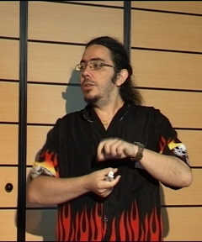

Heterogeneity in Data-Driven
Live Streaming:
Blessing or Curse?
Fabien Mathieu
Hot-P2P, 04/23/2010

Slide 2
Roadmap
Problem statement
  Model
  Motivation
Optimal broadcasting of a single chunk
  Many-to-one
  One-to-one
  One-to-c
Towards fast broadcasting of a stream of chunks
  Curses
  Blessings

Slide 3
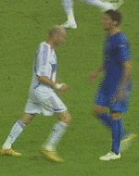
The Live Streaming Problem
A live stream (streamrate s) to watch…
Injected by a server of capacity
Watched by a set of N peers…
Goal #1: make it work!
Goal #2: make it fast!

Slide 4
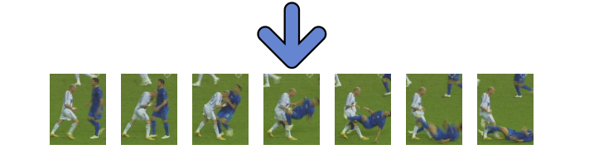
Chunk-based (aka data-driven) diffusion
Chunk-based: the stream is split into chunks of equal size;
Integrity-rule: only forward fully received chunks;
Upload-constrained: delay comes from upload bandwidth
u₁¸…¸ u_{N};
Bandwidth are expressed in chunks per second
No overlay constraints
! Oversimplified model to focus on heterogeneity
Notes:
Ensuite, quand il s’agit de s’occuper de manière effective de faire la diffusion, il existe généralement de méthodes découpage Duflot. Par bande ou par bandeau dans la méthode part de bande qui est celle que l’on va regarder maintenant le flux était coupé en morceaux de talcs égale. On définit une règle d’intégrité jusqu’à dire qu’un morceau ne peut pas être élite qui n’a pas été complètement reçu. Dans le modèle que l’on considère tout le délai est dû à la bande passante montante en d’autres termes délimitation du Haut était par exemple sont négligés par simplicité, on a supposé que dans passants sont triés par de décroissant toujours par se décider à supposer que toutes les bandes passantes de Libye sont exprimées en nombre de personnes enfin il n’y a aucune contrainte au niveau de gouverner ce qui signifie que n’importe qui de se connecter à n’importe qui de cette évidemment modèlent extrêmement simplifiées de diffusion est digne mais qu’il permettra de concentrer son point hétérogénéité.

Slide 5
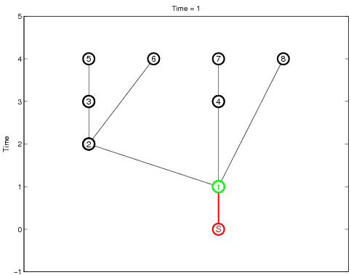
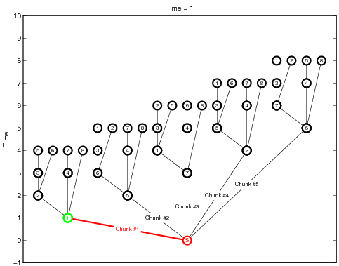
Optimal delay in the homogeneous case
Homogeneity allows to work in slotted time
The best way to broadcast one chunk takes
Extends to a stream of chunks by permutation of the single chunk tree

Slide 6
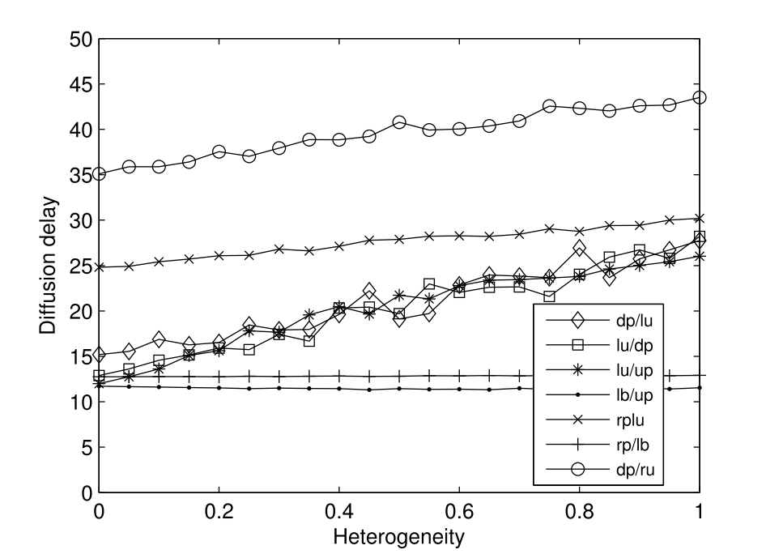
Optimal delay in the heterogeneous case
Nice formula for the optimal single chunk transmission: failed
Direct link single chunk / stream of chunks: failed
Intuition: should be faster (centralization is the extreme case)
In practice:
(Bonald et al., Sigmetrics, 2208)
Summary: heterogeneity is a b….

Slide 7
Model extension: forwarding policies
Authorize collaborations, or force parallelism:
Many-to-one: any set of peers with a chunk can forward that chunk in time 1/∑_{i}u_{i}.
  Not realistic at all, but so easier to compute;
  Will help understand the other models.
One-to-one (mono-source): a peer i with a chunk can forward it in time 1/u_{i}.
  the genuine model;
  slower than many-to-one, but more realistic.
One-to-c (parallelism): a peer i needs at least c/u_{i} to forward a chunk, up to c peers simultaneously.
  Extend the classical model;
  parallelism can avoid bandwidth waste, but it slower.

Slide 8
Delays under the model

Slide 9
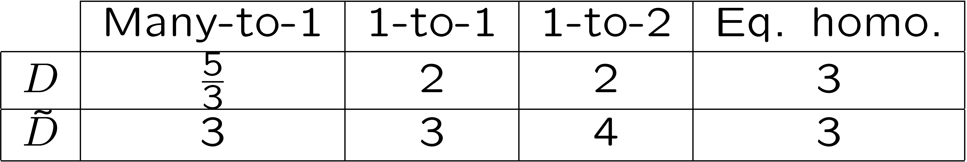
Example
3 peers, s=1, n₀=u₁=1, u₂=u₃=1/2
Exactly the bandwidth required according to Bandwidth Conservation Law (BCL)
Equivalent homogeneous system: n₀=1, u=2/3
Streaming is the issue

Slide 10
Single CHUNK

Slide 11
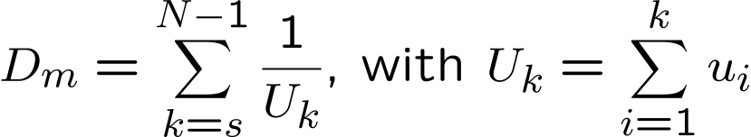
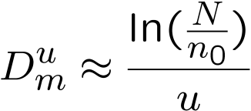

Results for the single chunk transmission
D_{m} is given by a simple greedy algorithm:
Gives
Absolute, tight, lower bound for chunk transmission.
Homogeneous case:

Slide 12
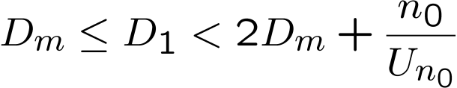
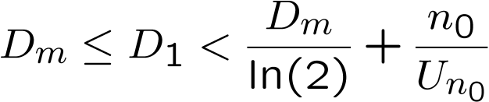
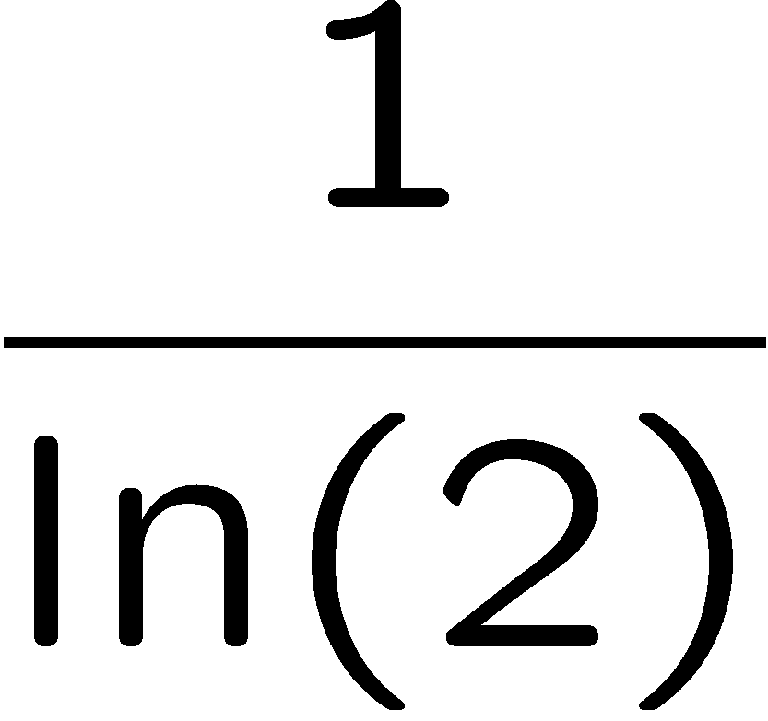
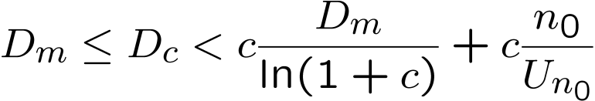
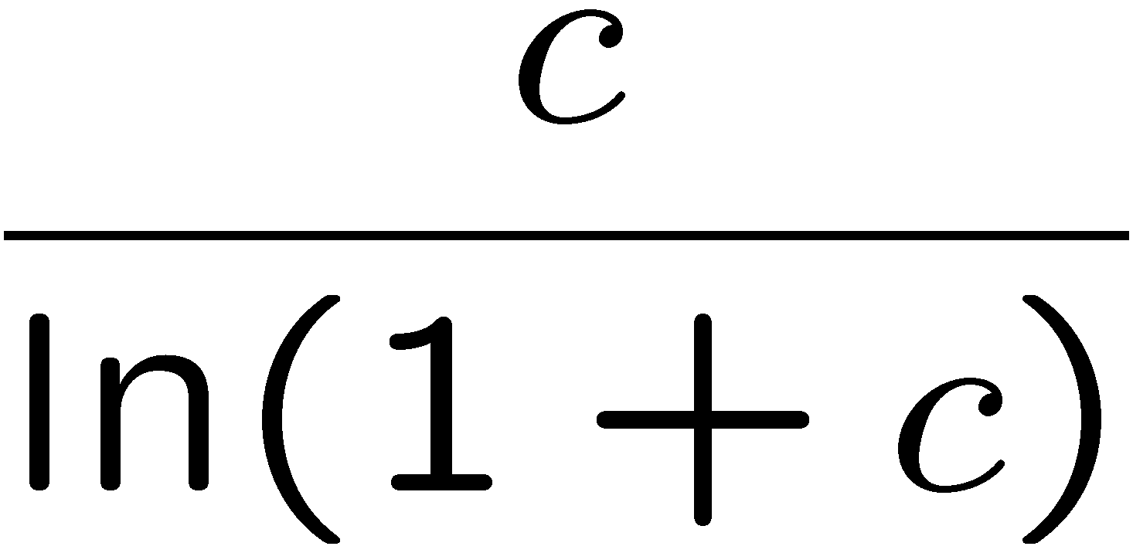
Results for the single chunk transmission
D₁ is also given by a simple greedy algorithm.
No simple, closed formula.
Theorem:
Conjecture (sigh!):
Price of atomicity is
Extension to parallelism:
Price of parallelism is

Slide 13
STREAM OF CHUNKS

Slide 14
Streaming case: feasibility

Slide 15
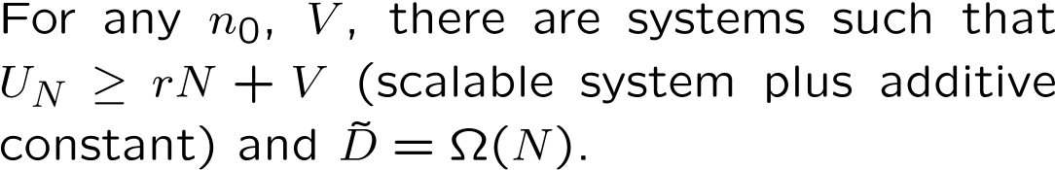
Bad case scenario
In the one-to-one model, poor peer may affect the delay
if you have to use them at some time
This can happen even in overprovisionned scenarios

Slide 16
Good case 1: emulating homogeneity
Assume we can find u such that
  (BCL of the emulated system)
  (emulation condition)
Then we have
Poor peers (u_{i}<u) are never used
Sufficient condition for u to exist:
factor 2 BW provisioning for quantification

Slide 17
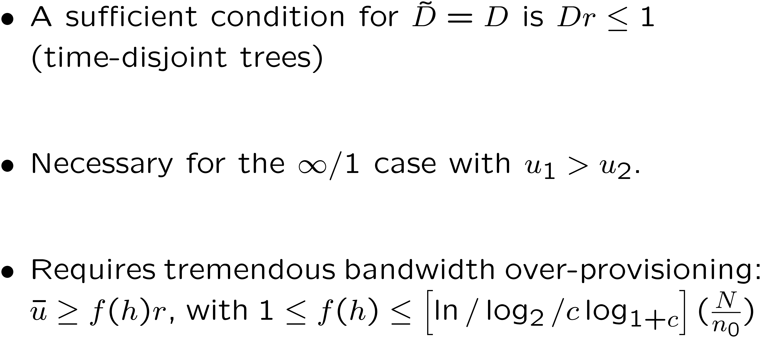
Good case 2: avoiding competition

Slide 18
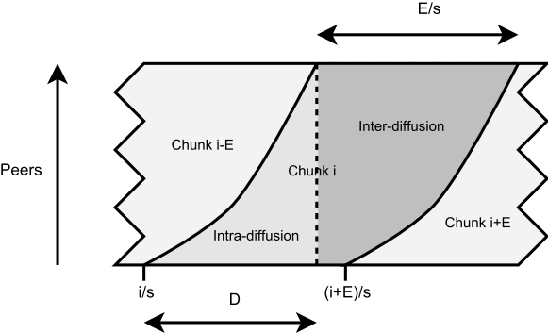
Good case 2: avoiding competition
Idea: protect the early diffusion to emulate the Dr· 1 case.
Recipe:
  Split the peers into E equal subsets, (E¼ Dr)
  All subsets should have roughly the original BW distribution.
  Round-robin the chunk injection among the subsets.
  Primary goal: intra-diffusion of the chunk.
  Secondary goal (when idle): broadcast to other subsets

Slide 19
Good case 2: avoiding competition
Proper validation of the idea still on-going
  Quantification effects can make some BW useless
  The subset must be as similar as possible
  (one monster peer in a single subset is hard to handle)
Lead to condition u¸ r(1+1/E)+cst, with E¼ log(N/n_0).
Corresponding delay almost like D
For some slightly overprovisionned systems, the stream delay is almost like the chunk delay

Slide 20
Chunk-based model and delay: summary
For homogeneous systems, single delay=stream delay
Collaboration for one chunk transfer is not that useful
Parallelism is not that scary
Heterogeneity speeds up single delay
Some bandwidth overprovisioning seems to be required in the general case

Slide 21
And then? Limits of the chunk-based model
Chunks comes from BitTorrent’s world
  Integrity purpose
  Great for unstructured approaches
  Big chunk reduce overhead
Good for theory
  Quantification
  Delay expressed as bandwidth
But when streaming is concerned…
  Need to go down to latency timescales
  Limits of the model validity
A possible lead for future work
  Do we really need strong integrity mechanisms?
  Try to learn from the stripe world

Slide 22
Thank you very many!
No interactive questions, but you can
Have a look at the paper
Email me (fabien.mathieu@orange-ftgroup.com)
22/22

